Slide 2
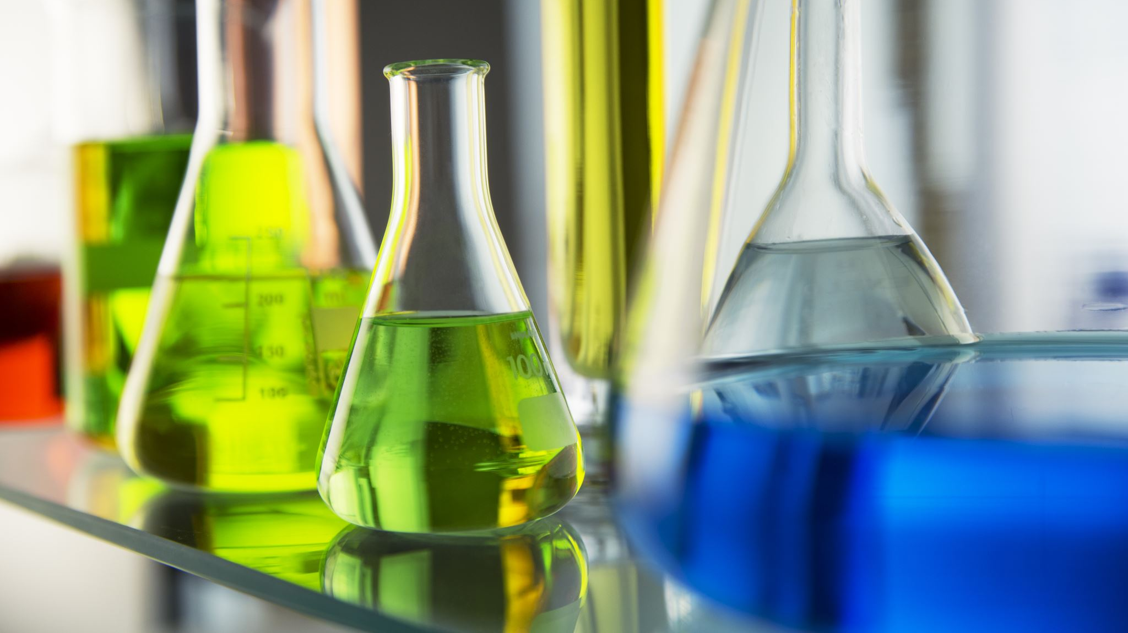
Volcano experiment
Ed and Smera

Slide 3
The experiment

Slide 4
Instructions:
Equipment:
Steps:
We will be using the following equipment.
Baking soda
Food coloring (optional)
Vinegar
Beaker
Measuring cylinders
First you get all the ingredients/equipment
Next you put around 50 grams of bicarbonate of soda into a beaker
Then you mix the vinegar with drops of food colorings of your choice
Then you pour in the vinegar
And watch the magic
Click here: to see the safety precaution

Slide 5
.Vinegar is corrosive and irritant .Baking soda is poisonous if taken into the body Make sure you wear gloves and googles when doing this experiment. After you have finished the experiment make sure to clean up and wash your hands.
Warning

Slide 6
Click the video to see our experiment:
Video
This video shows you the volcano experiment with the bicarbonate soda. Click the link to watch:
https://www.youtube.com/watch?v=wFSYLQkMR7U

Slide 7
How?
The red lava is the result of a chemical reaction between the baking soda and vinegar. In this reaction, the carbon dioxide gas is produced, pressure builds up inside the plastic bottle until the gas bubbles out of the ”volcano”.
The chemical equation:
NaHCO₃(s) + CH₃COOH(l) CO₂(g) + H₂O(l) + Na⁺(aq) + CH₃COO⁻(aq)
Note: where s = solid, l = liquid, g = gas, aq = aqueous or in solution
baking soda (sodium bicarbonate) + vinegar (acetic acid) carbon dioxide + water + sodium ion + acetate ion

Slide 8
More on how:
Acetic acid (a weak acid) reacts with and neutralizes sodium bicarbonate (a base). The carbon dioxide that is given off is a gas. Carbon dioxide is responsible for the fizzing and bubbling during the "eruption." The baking soda and vinegar volcano erupts because of an acid-base reaction.

Slide 9
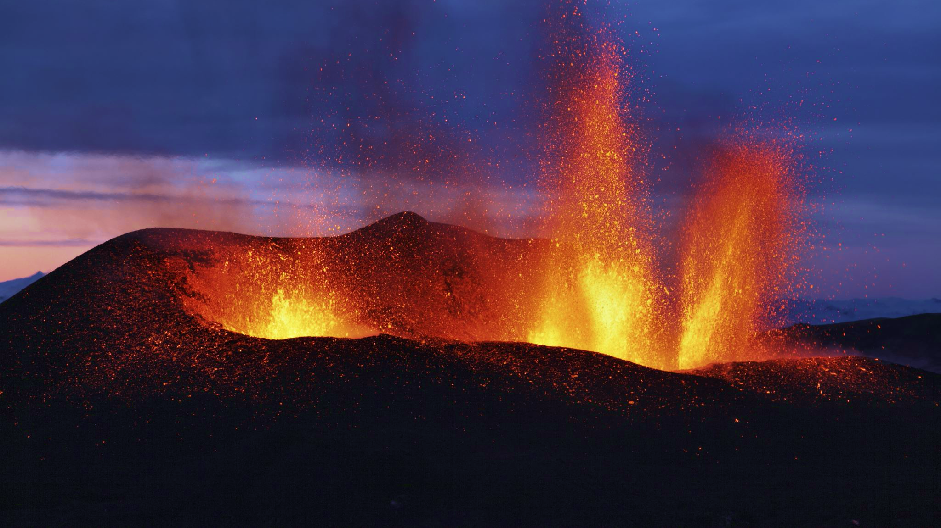
Real volcanoes

Slide 10
What?
A volcano is a vent in the earth's crust through which lava, rock fragments, hot vapor and gases are ejected. A volcano begins to form when magma, which is hot molten rock from deep within the earth, rises toward the earth's surface and collects in magma chambers. Volcanoes can be active, dormant, or extinct.

Slide 11
How do they work?
Pressure/eruption volcano: During an eruption, magma makes its way to the surface, where, if it erupts quietly, it is labelled as lava. Deep down, the high-pressure environment forces gases to dissolve in the magma but as it rises, the falling pressure allows gas bubbles to escape.
Lava/silica volcano: Magma contains many elements, but oxygen and silicon are the most abundant. These combine to form silica, which forms long polymer chains.
Gas eruption volcano: Gases emerge from magma at different depths, thanks to different solubilities. While carbon dioxide releases deep down, at high pressure, sulphur dioxide escapes higher up. A sudden increase in the ratio of carbon dioxide to sulphur dioxide can be a warning to scientists that magma is on the move.

Slide 12
Thank you

