Slide 1
Making a radio out of my electronics kit
By Marianne Gorton

Slide 2
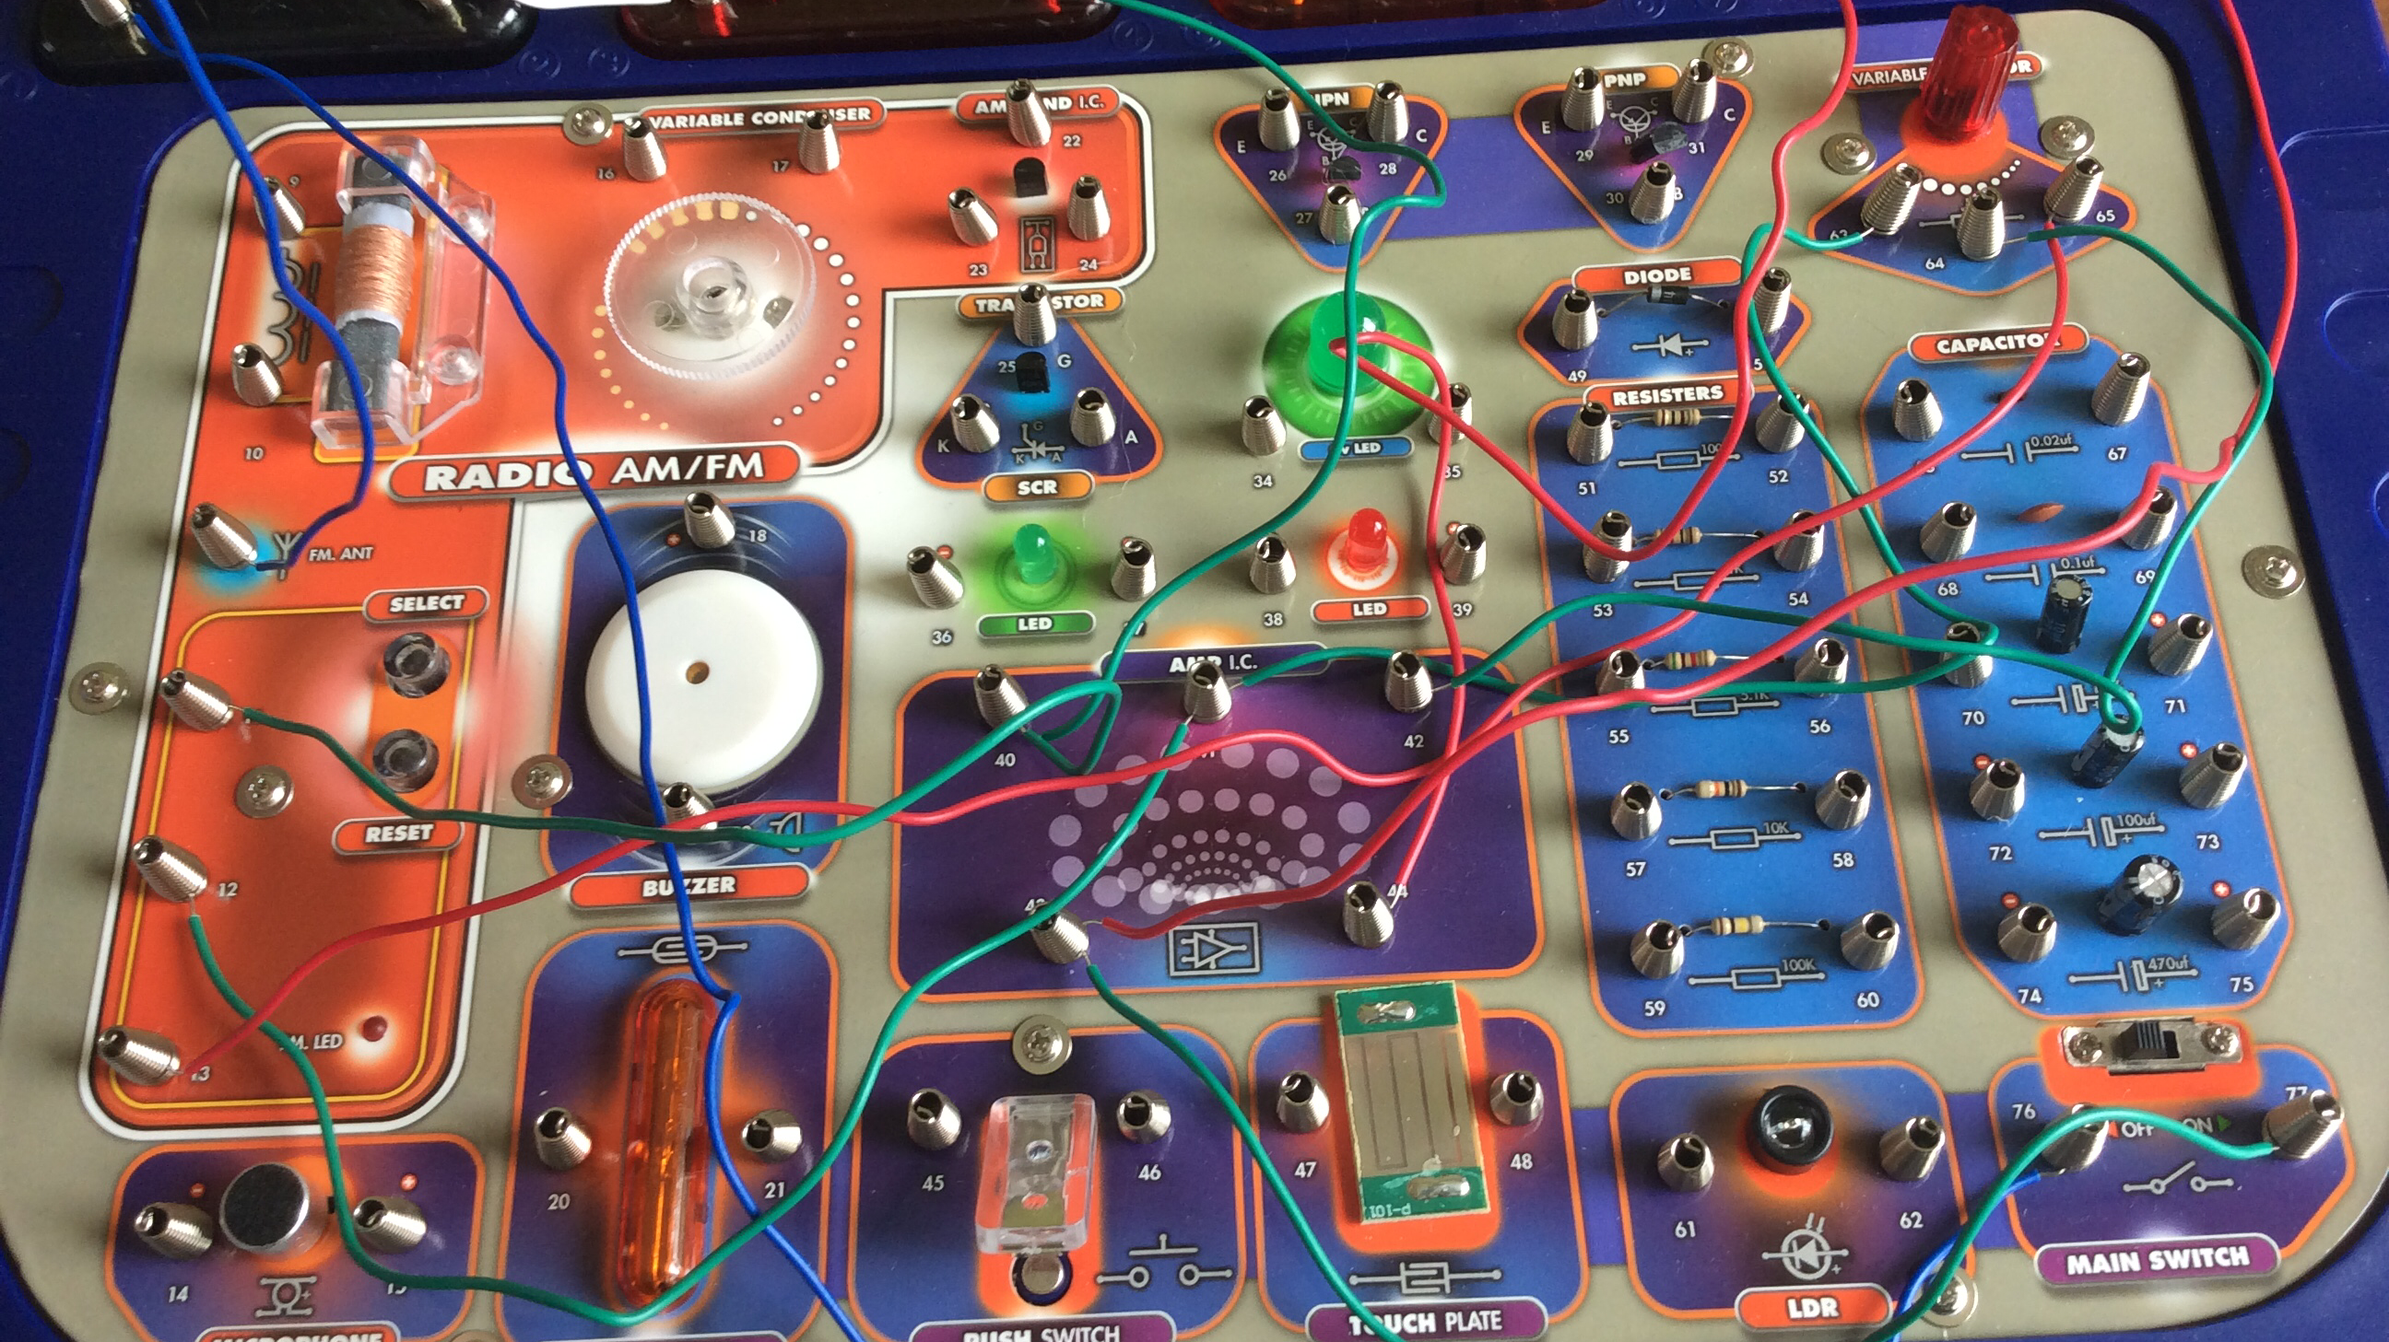
Wiring for the radio

Slide 3
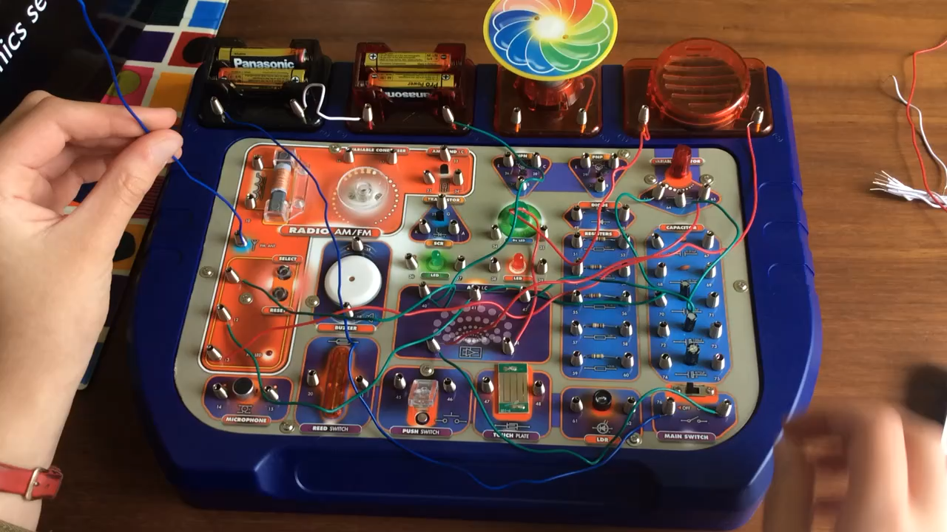
Notes:
Video of the radio

Slide 4
Thank you

