Slide 1
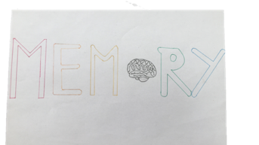
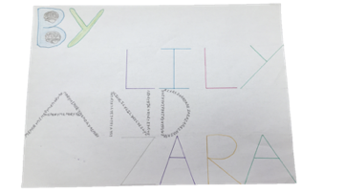
Memory
By Lily and Zara

Slide 2
introduction
What are we trying to find out?
We are trying to find out whether, images improve your verbal memory, what the easiest colour to remember is, what the easiest shape to remember is, and what the easiest shape colour combination to remember is
And how will we do it?
We will do this by carrying out 4 experiments; the text experiment, the colours experiment, the shapes experiment, and the coloured shapes experiment

Slide 3
The text experiment

Slide 4
What do we want to find out?
Do visual aspects increase your verbal memory?
Do they decrease your verbal memory?
Or do they do nothing?

Slide 5
What is the text experiment?
We gave our family members two pieces of text, one with pictures and one without
We then asked them 5 questions on each piece to see if pictures helped them remember better

Slide 6
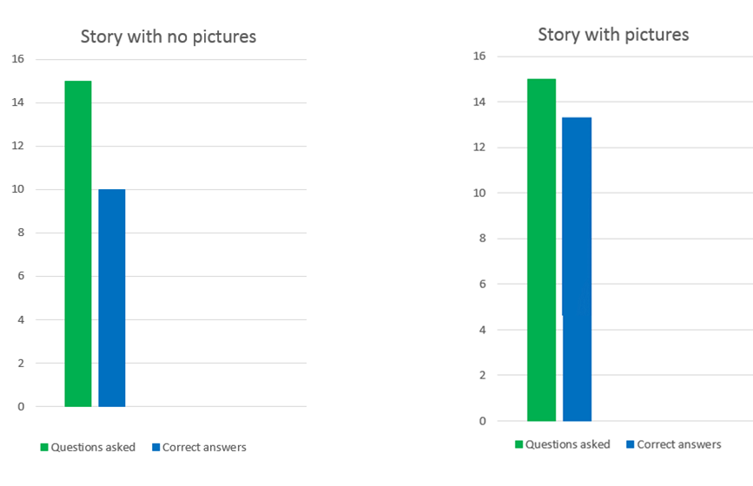
Our results

Slide 7
Conclusion for the text experiment
What did we find out?
As you can see on the previous slide having images helps you remember better
How would this be useful in real life?
If making notes for a test draw a little picture next to it

Slide 8
The Shapes experiment

Slide 9
What is the shapes experiment?
On the following slide you will see 8 different shapes, look at them for 30 seconds then write down the ones you remember

Slide 10
This is the same coloured shapes used in the experiment
Test yourself! How many can you get?

Slide 11
What do we want to find out?
Which shape people find it easiest to remember.

Slide 12
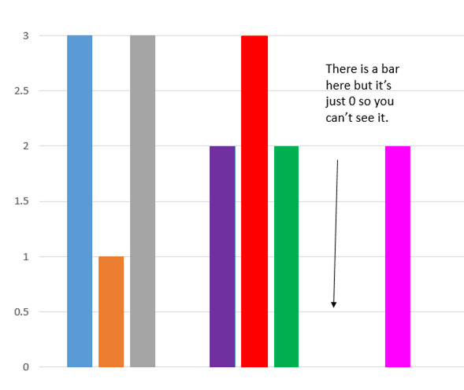
Our results
For every shape remembered we gave it a point so if it was remembered once we gave it 1 point and so on for the rest.
From left to right
Triangle
Star
Curved arrow
Crescent moon
Cross
Splat
The circle with one straight edge
Diamond

Slide 13
Conclusion for the shapes experiment
What did we find out?
The easiest shapes to remember are the triangle, the curved arrow, and the cross.
How could this be useful in real life?
Write things you need to remember in one of the shapes above.

Slide 14
Colours experiment

Slide 15
What is the colours experiment?
On the following slide you will see 10 coloured squares, look at them for 10 seconds, wait a minute then write down the ones you remember in a list.

Slide 16
These were the colours used in the experiment.

Slide 17
What do we want to find out?
Which colour people find it easiest to remember

Slide 18
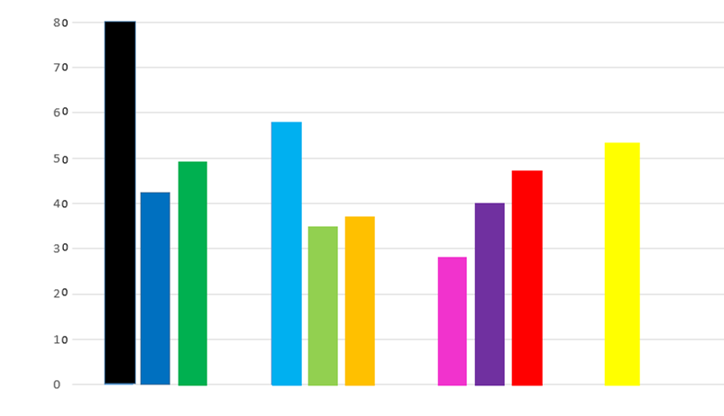
Our results
We recorded our results using points. For example, if yellow was the second colour remembered and purple was the eighth, yellow would get 9 points and purple would get 3 and the same for the other colours.
(Sorry if the numbers look weird, I had to put the zeros in myself and it was quite difficult as the graph would go up in 20s otherwise. Also I couldn't get a graph without the bars placed like that, but I tried my best.)

Slide 19
Conclusion for the colours experiment
What did we find out?
We found out that the easiest colour to remember is black, and the hardest is pink
How could this be useful in real life?
If making notes for an exam write them in black or light blue rather than pink or light green

Slide 20
The coloured shapes experiment

Slide 21
What is the coloured shapes experiment?
On the next slide you will see 8 coloured shapes. Look at them for 30 seconds then write down the ones you remember in a list

Slide 22
This is the same coloured shapes used in the experiment
Test yourself! How many can you get?

Slide 23
What do we want to find out?
Which shape and colour combination is easiest to remember.

Slide 24
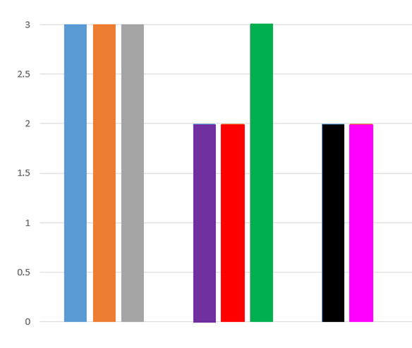
Our results
We recorded our results for this experiment in the same way as the shapes experiment
From left to right
Orange square
Purple triangle
Green circle
Black arrow
Blue triangles together at the tip
Yellow sun
Red heart
Grey ring
Sorry the colours of the bar aren't the same colours as the shapes I had already made it and it was too late to go back.

Slide 25
Conclusion for the coloured shapes experiment
What did we find out?
The easiest shape and colour combinations to remember are, the orange square, the green circle, the purple tringle, and the yellow sun
How could this be useful in real life?
Write notes in one of the coloured shapes above rather than on plain paper

Slide 26
conclusion
What did we find out
Images help you remember things better
The easiest shapes to remember are the triangle, the curved arrow, and the cross
The easiest colour to remember is black
The easiest coloured shapes to remember are the orange square, the purple triangle, the green circle, and the yellow sun.
How can we use this in everyday life?
In school life if you had a test to help you revise you could have some text in an orange square or in a cross or using black text and it might help you to remember. Then maybe you could draw a little picture next to it.

Slide 27
Thank you for watching our presentation!
Memory- by Lily and Zara

